Slide 1
ART SAVING LIFE
Ginger Garden 2015
Janet Jian Liu
Aug 27, 2015
Notes:
This template can be used as a starter file for a photo album.

Slide 2
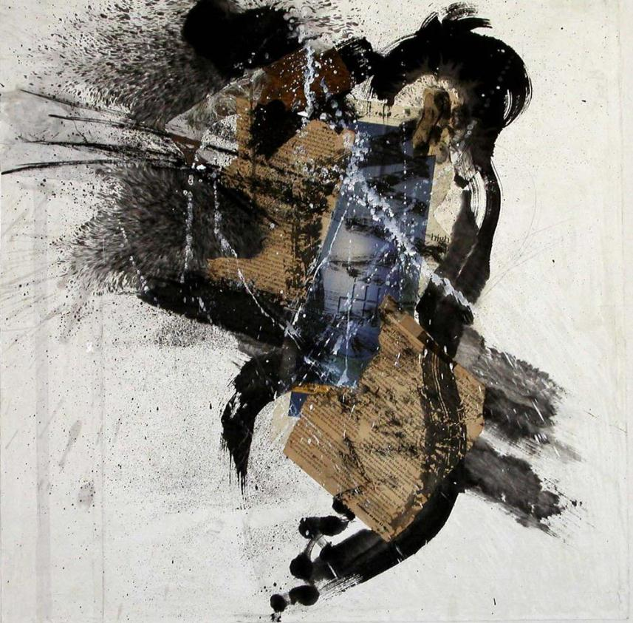
About MY ART
Introducing

Slide 3
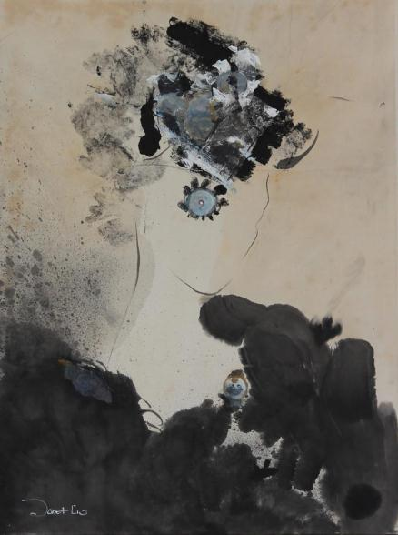
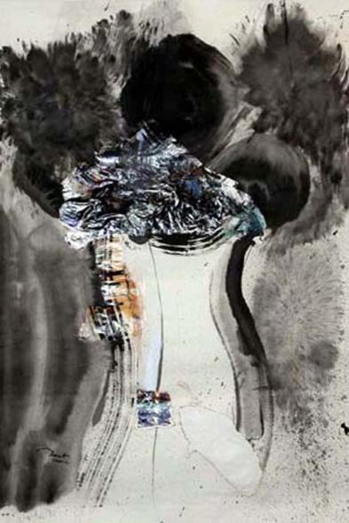
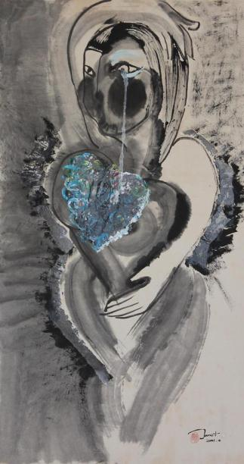
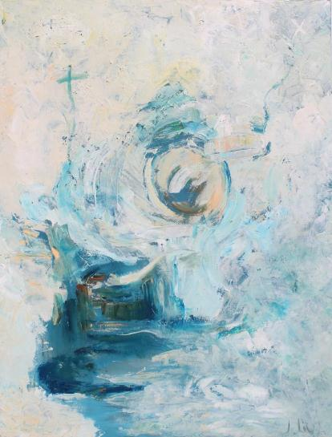
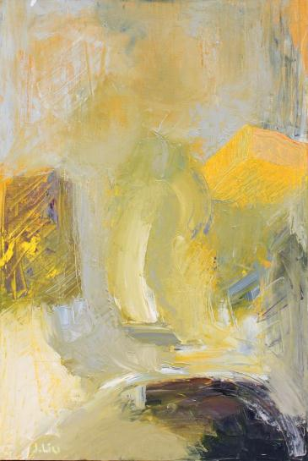
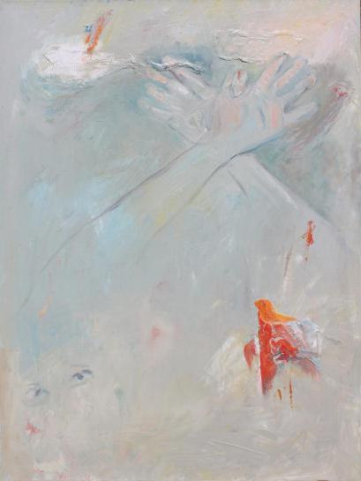
Before
After
Emotional Moment is an abstract mixed media painting series inspired by my journey through and beyond breast cancer. These works explore the shifting emotional landscapes of day to day life with the disease – fear, darkness, joy, hope, faith, and ultimately the desire to live and love.

Slide 4
2008
2008
we setup charitable organization
We believe that POSITIVE THINKING IS A KEY WHICH UNLOCKS THE SECRET OF A HAPPY AND FULFILLING LIFE.

Slide 5
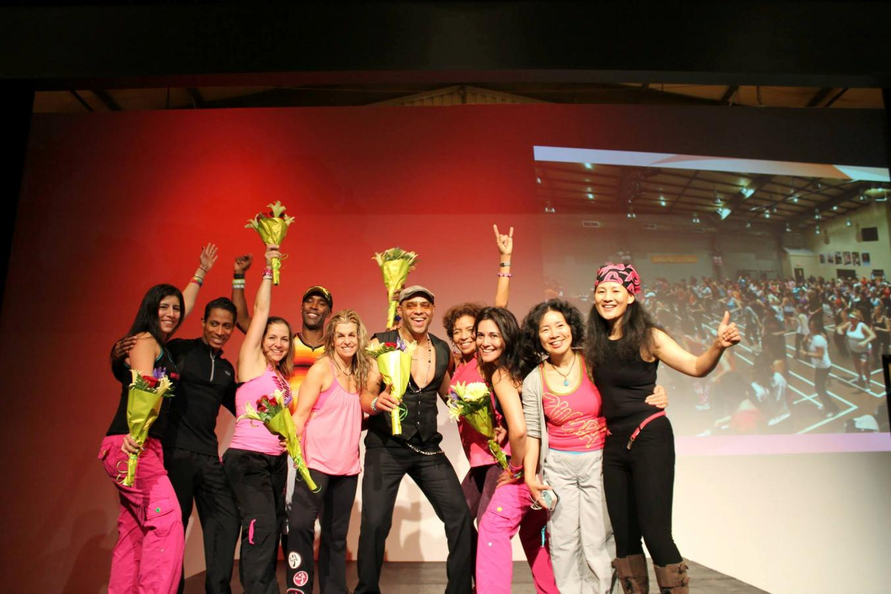
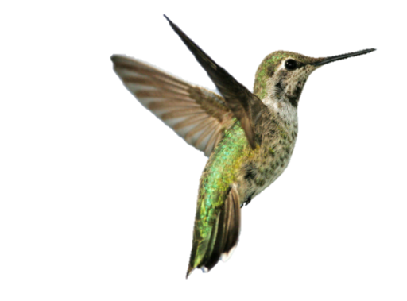
Zumba for Hope Annually Breast Cancer
Fundraising Party

Slide 6
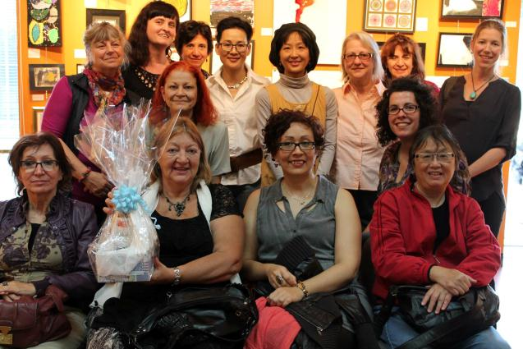
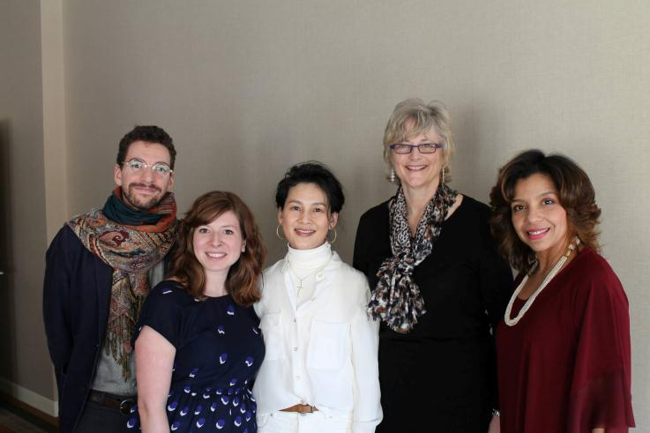
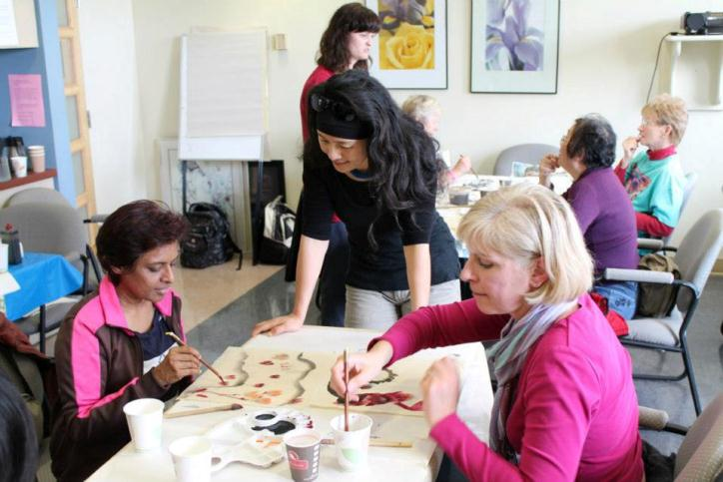
Charitable Programs
Activities

Slide 7
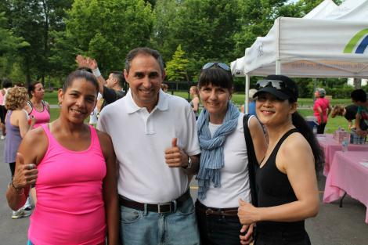
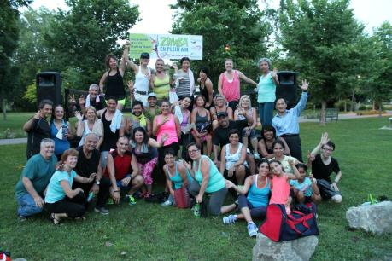
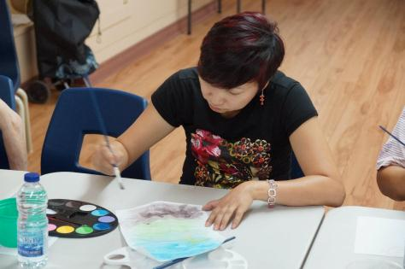
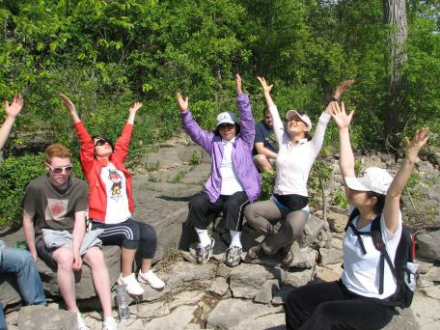
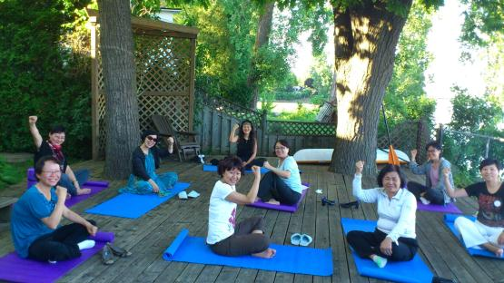
ART IS PART
OF CURE
CREATIVE

Slide 8
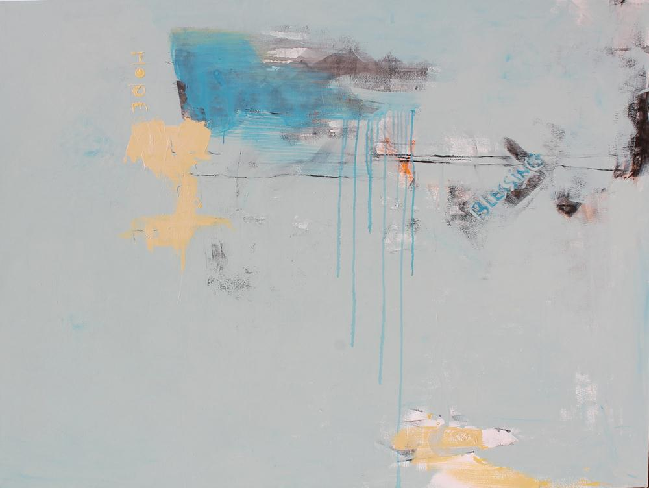
I AM BLESSING

