Slide 1
Co-Presented by:
Cynthia Or
Sam Lu
Tina-Hanaé Miller

Slide 4
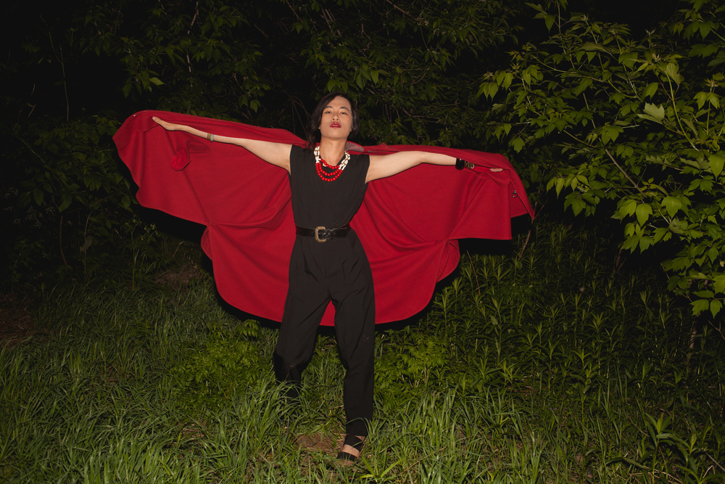

Slide 5
